Slide 1
SC1015
Mini Project
Suicide Prediction
https://github.com/bertrainn/SC1015_SC5_Group6_MiniProj
Notes:
Good morning prof and TA, I am Bertranne Lee and together with my group mate Hong Yi we will be presenting our mini project for SC1015
Suicide Prediction.

Slide 2
Members
Dataset Used
Bertranne Lee Zi - Wen (U2120209L)
Goh Hong Yi
(U2120049J)
Lee Wen Wei
(U2120178J)
Group 6
Suicide Rates Overview 1985 to 2016
By Rusty
Notes:
The dataset we used for this project is the suicide rates overview from 1985 to 2016 by Rusty from Kaggle

Slide 3
TABLE OF CONTENTS
01
02
03
04
Problem
Statement
Data Exploration
Modelling and Evaluation
Conclusion /Learning Points
Notes:
The flow of this presentation will be as follows: Our problem formulation and statement, data exploration, modelling and evaluation and finally the conclusion and our learning points

Slide 4
Problem Statement
01
Notes:
Starting with our problem statment

Slide 5

Practical Motivation
According to the World Health Organisation, more than 700 000 people die due to suicide every year. With more attempting it.
What attributes will affect a country’s suicide rate?
Notes:
We know what suicide is a major problem that is affecting our current society and according to the world health organization more than 700k people die from it every year
As such our group has asked ourselves what could be the possible attributes that could contribute to a country’s suicide rate.

Slide 6

Problem Statement
To create a machine learning model that can predict a country’s suicide rate based on it’s attributes.
Prediction of a numeric value (Suicide Rate)
Notes:
As such our goal for this project is to create a machine learning model that can help predict a country’s suicide rate based on its attributes. As such we are trying to predict a numeric value

Slide 7
Data Exploration
02
Notes:
Now let us begin our data exploration process
We will be looking through the data of over a 100 countries over the span of 31 years to identify potential variables from both numeric and categorial columns that will be helpful for us in trying to predict a country’s suicide rate

Slide 8
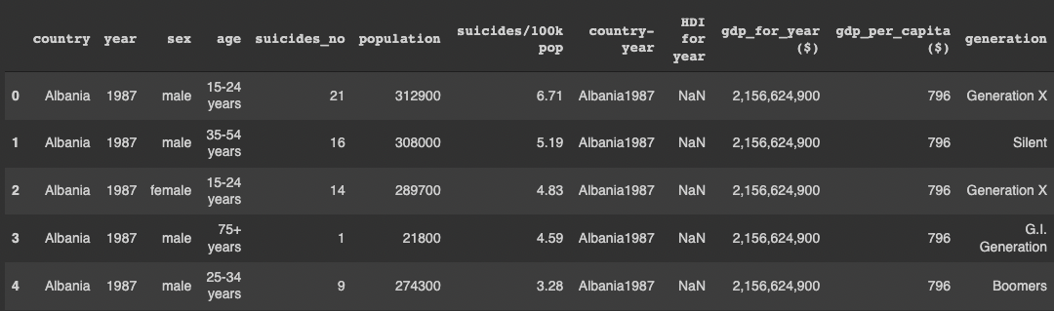
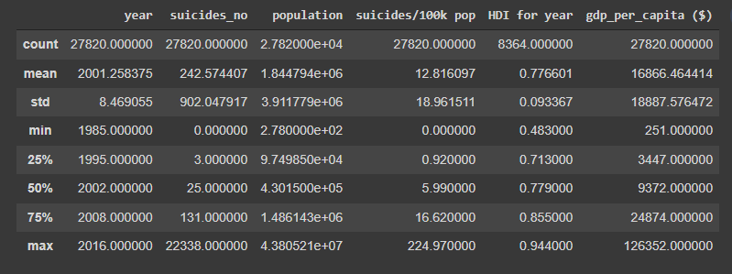
Preliminary Analysis
Notes:
Starting off with the preliminary analysis
Our data set comprised of 12 columns

Slide 9
Preliminary Analysis
Categorical
Numeric
Notes:
which can be broken down into 5 Categorial and 7 Numeric columns

Slide 10
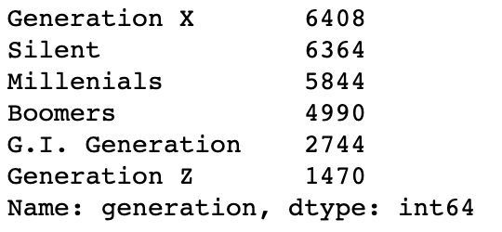
Preliminary Analysis
Generation Definitions
GI – Generation = 1901–1927
Silent = 1928 – 1945
Boomers = 1946 – 1964
Generation X = 1965 – 1980
Millennials = 1981 – 1996
Generation Z = 1997 - 2012
Notes:
for this presentation, the values in the generation column will be defined as the following age groups as shown on the right of the screen.

Slide 11
Pre-Processing
Country
Year
Sex
Age
Suicide_no
Population
Suicide/ 100k pop
Country-year
HDI for year
Gdp_for_year
Gdp_per_capita
Generation
Country
Year
Gender
Age_group
Suicide_count
Population
Suicide_rate
Country-year
HDI for year
Gdp_for_year
Gdp_per_capita
Generation
Notes:
We will be doing some preprocessing before we fully go into our analysis and data visualisation.
The main bulk of pre-processing will be changing the column names to more appropriate titles such as changing suicide / 100k population to suicide rate as shown above

Slide 12
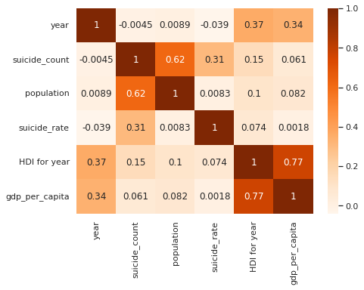
Data Visualisation
Notes:
Countries with a higher population have a higher suicide rate: due to the higher number of people in the country leading to more possible casualities

Slide 13
Data Visualisation
Notes:
Looking at suicide rates we can see that suicide count has the strongest corellation out of all the values but this should be inherent as
Suicide rate is based off suicide count

Slide 14
Data Visualisation
Notes:
Looking further into suicide_count

Slide 15
Data Visualisation
Notes:
We can see that there is a positive linear relationship between population and suicide_count which could be indicative of a useful variable to help us in predicting suicide rate.
However this could also be due to the idea that if a country has a higher population there are more people to potentially commit suicide.

Slide 16
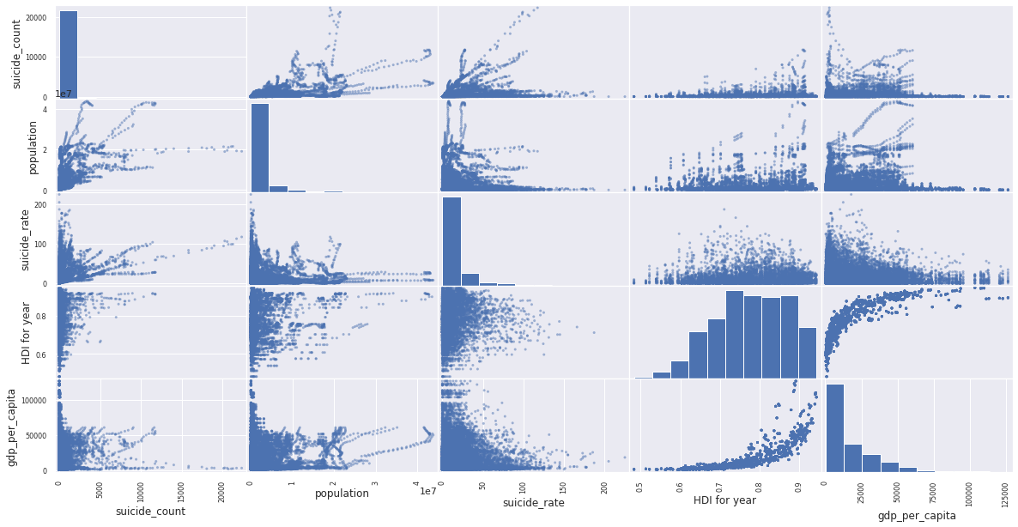
Data Visualisation
Notes:
Looking at a scatter matrix of our numeric values to detect potential outliers in our dataset, in general the data does not have many outliers however, we will still be taking it into account during our data cleaning step

Slide 17
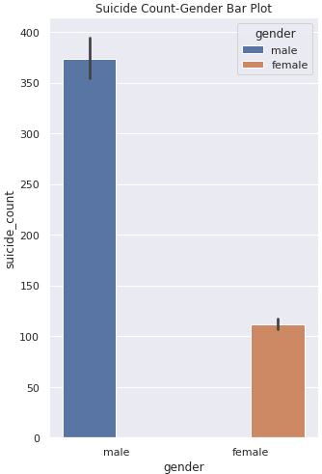
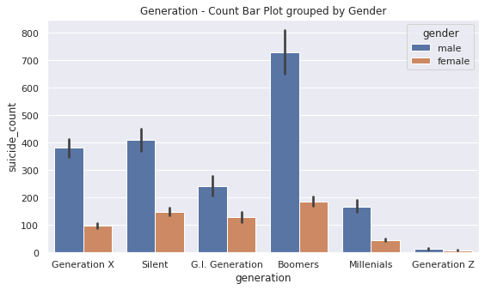
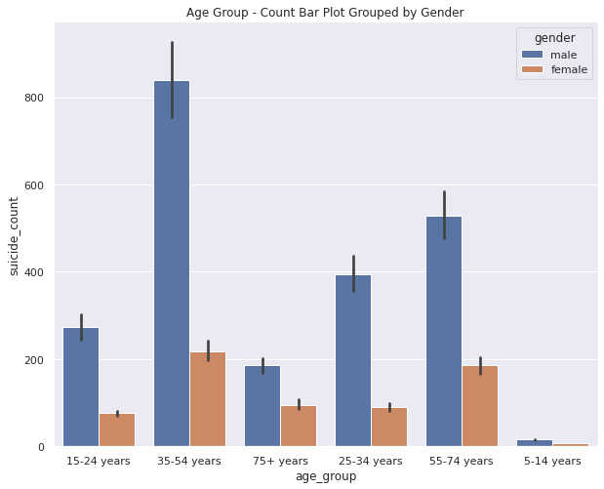
Data Visualisation
Notes:
When plotting suicide rate against gender we can clearly see that males are more likely to commit suicide than females

Slide 18
Data Visualisation
Notes:
Breaking down the gender by generation and age group we see that 35 – 57 y/o and boomers commit suicide the most

Slide 19
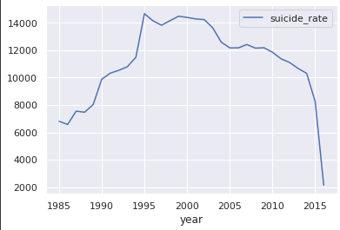
Data Visualisation
Notes:
Using a line plot, we are able to see how suicide rates in general have changed over time.
As we can see after 2005, suicide rates have generally decreased, with a even steeper drop after 2010.
However, the low suicide rate after 2015 could be due to the imcompleteness of the dataset as it does not account for the whole 2016 which could explain the low number after 2015.

Slide 20
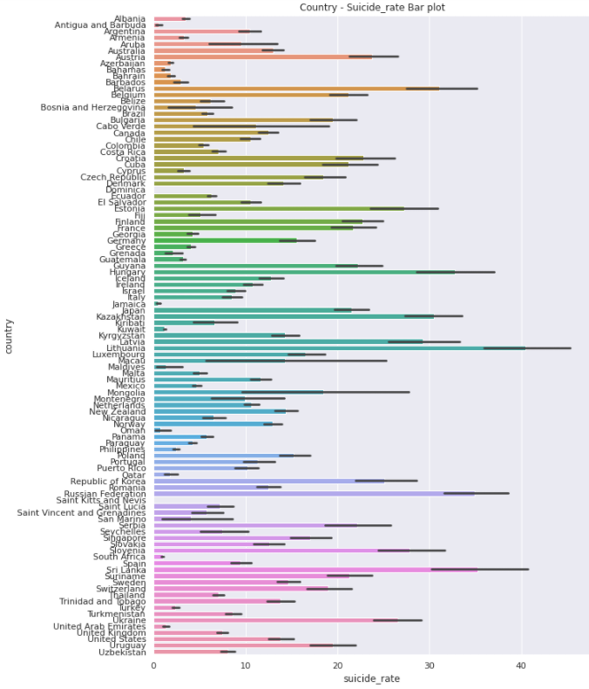
Data Visualisation
Notes:
When creating a barplot of all the country’s and their suicide rate,

Slide 21
Data Visualisation
Notes:
We can see that Sri Lanka and Lithuania has the highest suicide rate among the 101 countries that we have looked at.

Slide 22

Findings from Data Exploration
Males have a higher likely hood of committing suicide regardless of age group or generation
Suicide has been on an overall downwards trend in recent times
Countries with a high population have a higher suicide rate
Notes:
Next I’ll be passing my time to hong yi who will be discussing about our data cleaning and machine learning process

Slide 23
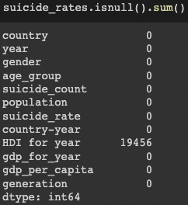
Data Cleaning
Checking for Null Values
Notes:
Moving on to categorical variables, we use bar plot to showcase the relationship between the variables.

Slide 24
Data Cleaning/ Processing
Numerous Categorical Data which hinders the ML process

Slide 25
Data Cleaning/ Processing
Use of Label Encoding to convert categorical variables to numeric

Slide 26
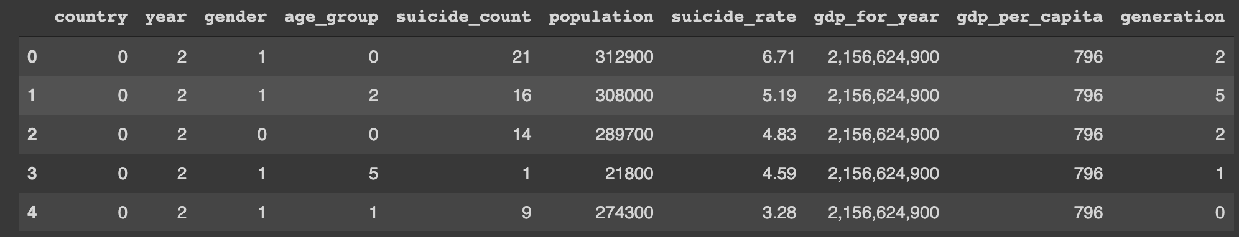
Data Cleaning/ Processing
Label Encoding

Slide 27
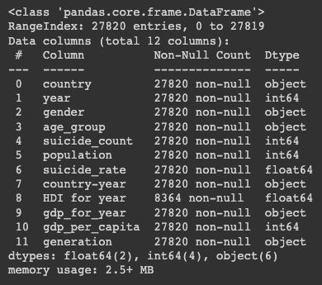
Data Cleaning/ Processing
Dropped Columns
HDI For Year
Country - Year
Pre-Cleaning
Removed Outliers and Null Rows
Label Encode the categorical values
Notes:
Remove HDI - due to the large number of NULL values.
Country - Year as it is a column that is a combination of country and year and hence is redundant.
Remove outliers and NUll rows
And finally converting categorical to numeric to facilitate the machine learning process

Slide 28
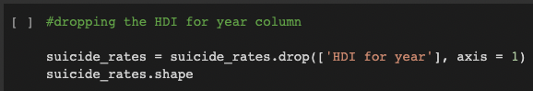
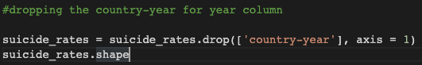
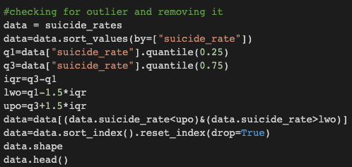
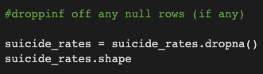
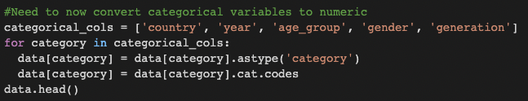
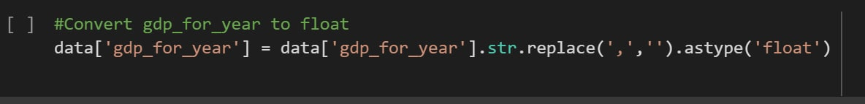
Data Cleaning/ Processing
Pre-Cleaning

Slide 29
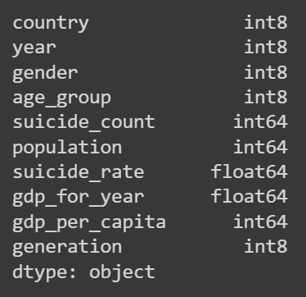
Data Cleaning/ Processing
Post- Cleaning
Pre-Cleaning

Slide 30
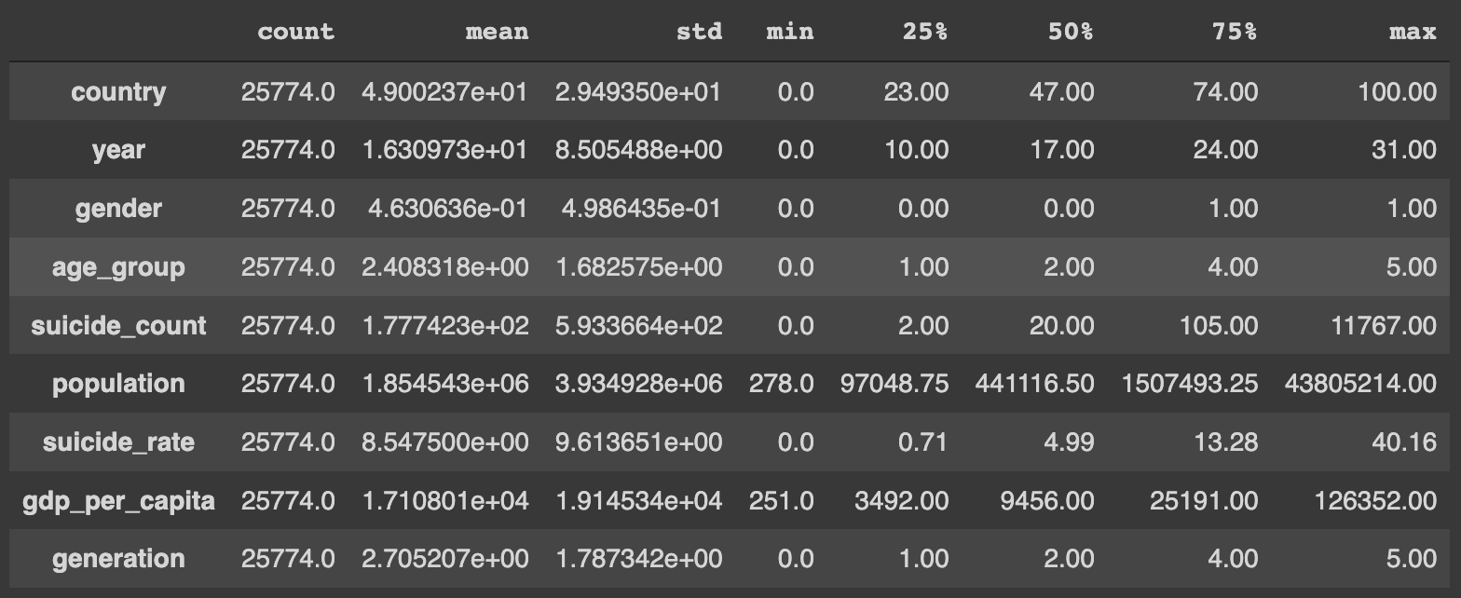
Data Cleaning/ Processing
Post- Cleaning

Slide 31
Predictive Modelling
03

Slide 32
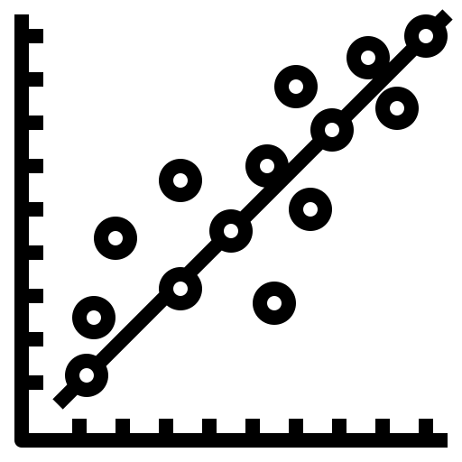

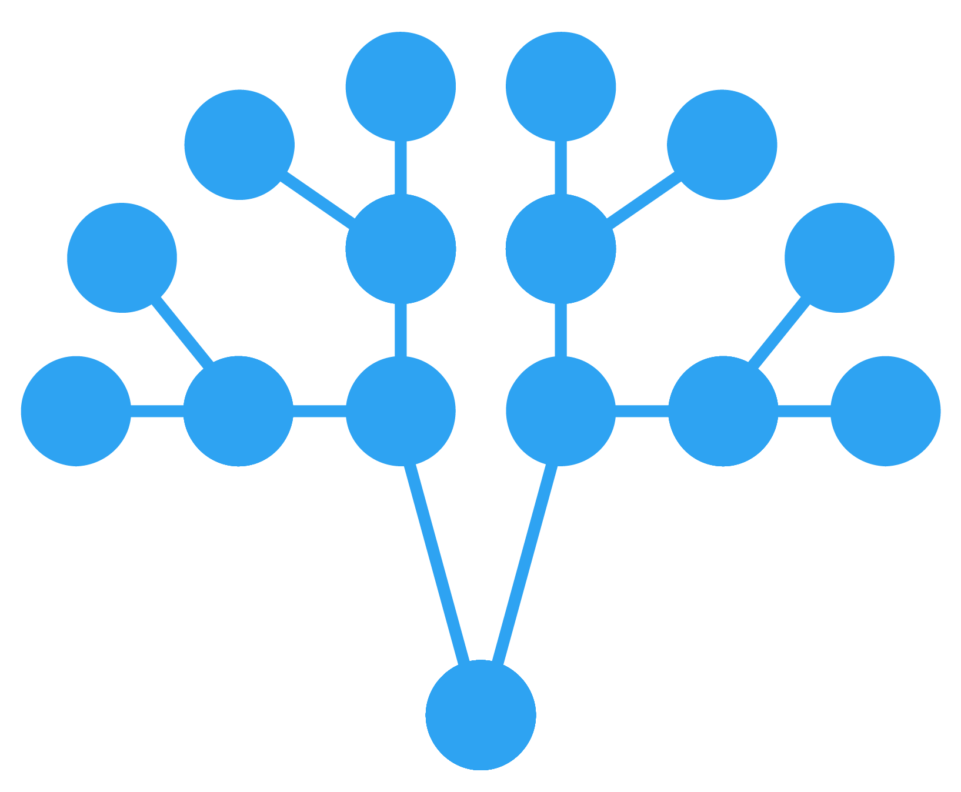
OUR SOLUTIONS
Linear Regression
Regression Tree
Model linear relationship between variables
Bagging and Feature Randomness
Random Forest & Gradient Boosting
Accuracy improvements to a Regression Tree

Slide 33
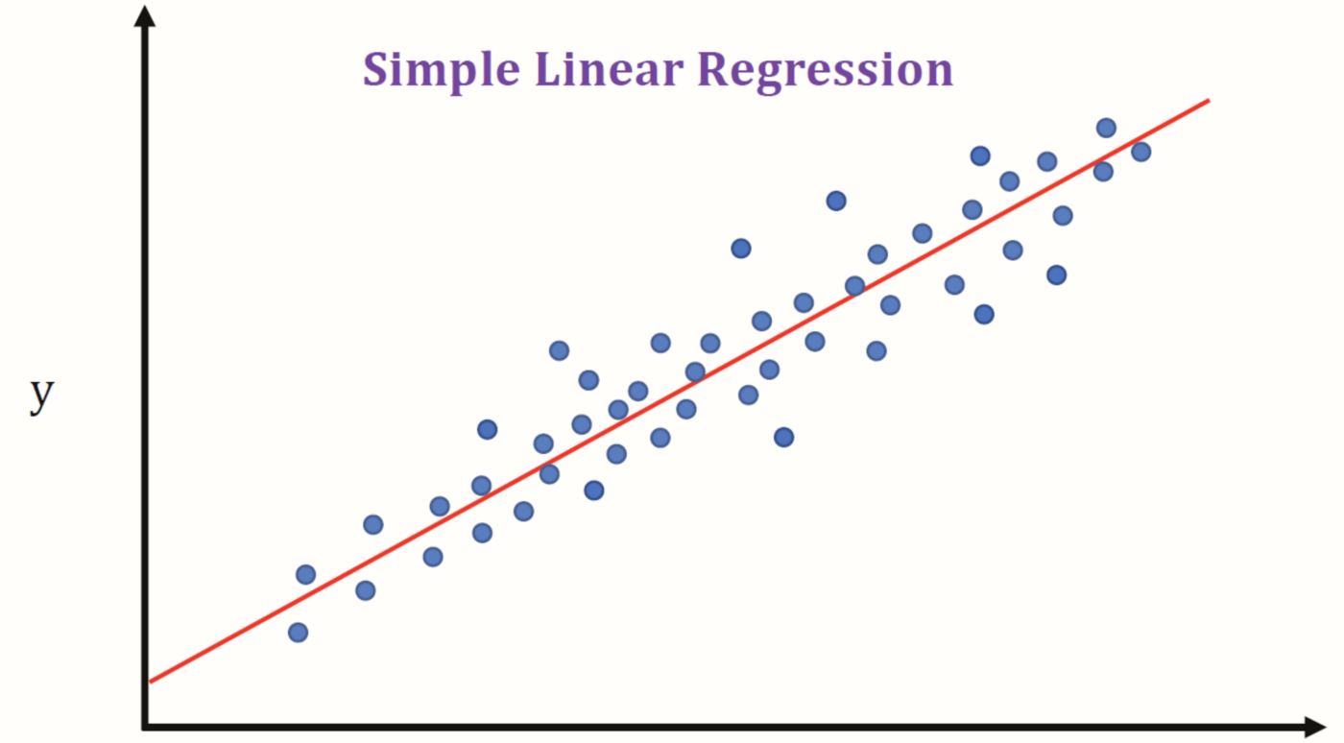
Linear Regression
Assumes a linear relationship between 2 variables.

Slide 34
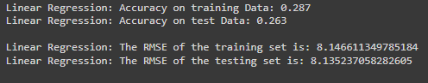
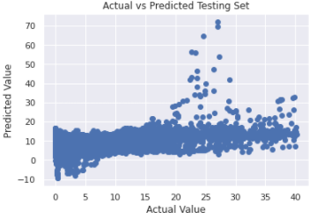
Linear Regression
Low accuracy and High RMSE
Does not suit linear relationship

Slide 35
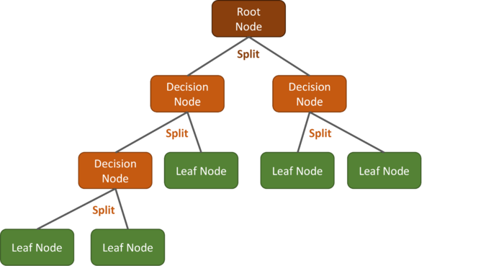
Regression Tree
Similar to a Decision Tree
Used to predict numerical values

Slide 36
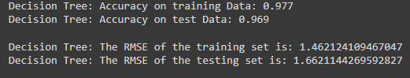
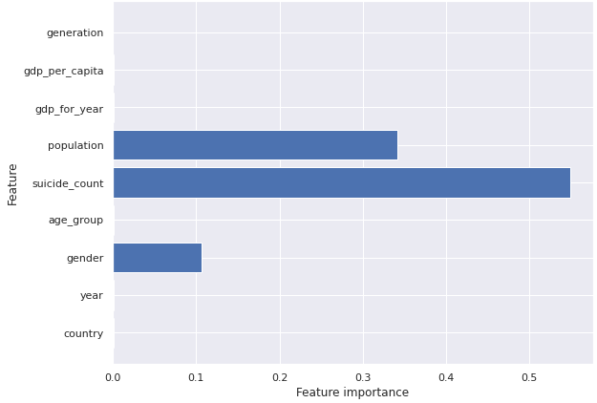
Regression Tree
High accuracy and low RMSE.
Suicide count is & population seem to be key variables to suicide rate.

Slide 37
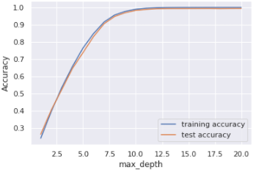
Regression Tree
Increase in accuracy is insignificant after depth of 10.
Accuracy can be improved
Bagging
Boosting

Slide 38

Random Forest
Classification algorithm
Collection of decision trees
Bagging
Feature Randomness
Improved accuracy compared to a single DT

Slide 39
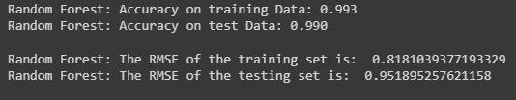
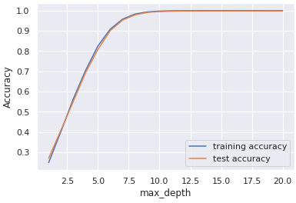
Random Forest
Higher accuracy and lower RMSE than Regression tree.
Surprisingly, the RMSE of the testing set is better than the training set.
Increase in accuracy is insignificant after ~9.5.

Slide 40
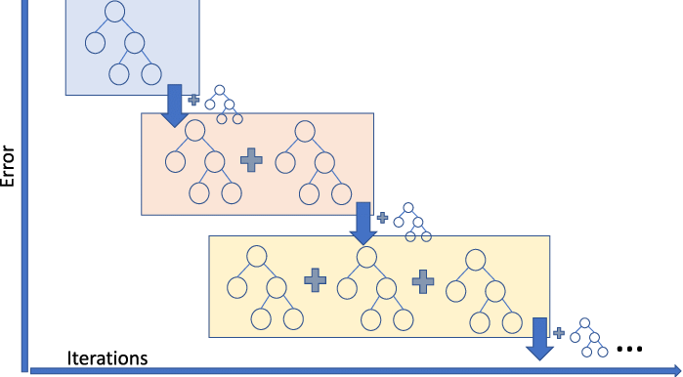
Gradient Boosting
Decision/ regression tree that is constantly improved
Based on the previous tree's errors

Slide 41
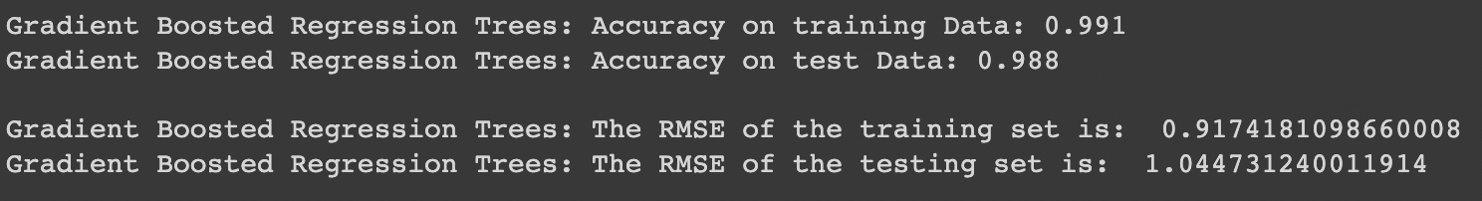
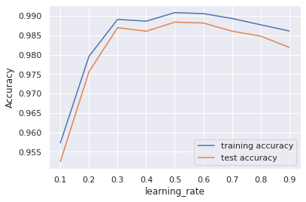
Gradient Boosting
Higher accuracy and lower RSME than Regression Tree
Better performance on the training set

Slide 42
Conclusion/ Learning Points
04

Slide 43
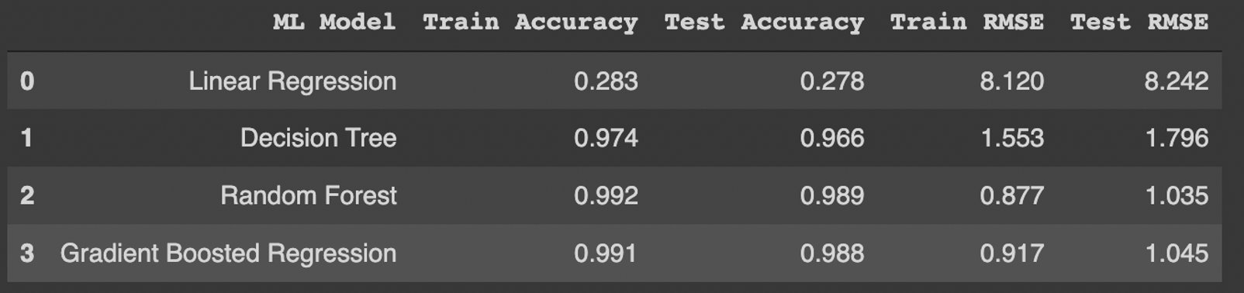
Conclusion
Random forest is the best model to predict suicide rate since it gives highest accuracy and lowest RMSE.
The greatest factor that affects suicide rate is gender, since males have higher suicide rate compared to women regardless of the generation or age group.
Since GDP per capita has a low correlation with suicide rate, it does not affect a country’s suicide rate to much extent.

Slide 44
Learning Points
Data visualisation techniques to understand and analyse dataset
Converting categorical variables to numeric variables using Label Encoding
Using decision tree to perform regression instead of classification
Using new models to perform regression with higher accuracy than Decision Tree which are not taught within the course such as Random Forest and Gradient Boosting Regression
Understanding the main causes of suicide rate and that suicide is not caused by a country’s economy, and is in fact caused by the people’s mindset

Slide 45
Thank You
https://github.com/bertrainn/SC1015_SC5_Group6_MiniProj
Notes:
Thank you for your attension
Any additional information will be in the github repo in the link at the bottom of your screen.

